Slide 1
Bike sharing
Detail report generated from the given data

Slide 2
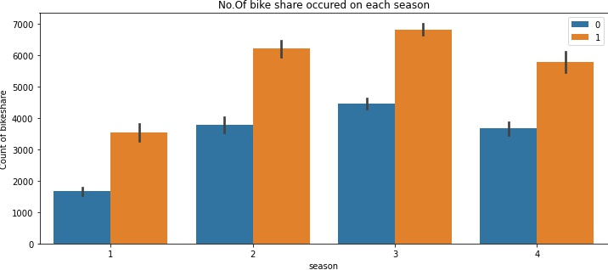
Understanding of the data From the given Data Dictionary we can know that season mentioned in the data is 1:spring, 2:summer, 3:fall, 4:winter. From the graph we can understand that the season 3 which is the fall season, has the highest number of bike share occurred in both the year 2018 and 2019. This show that there is a demand in the season of fall.

Slide 3
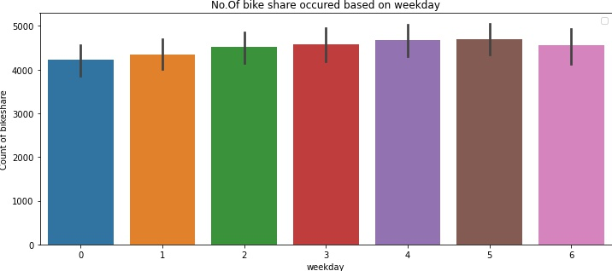
We can assume that the column weekday is represented as 0:Sunday, 1:Monday, 2:Tuesday, 3:Wednesday, 4:Thursday, 5:Friday, 6:Saturday by the information given in Data Dictionary. From the graph we can understand that Thursdays and Fridays are having the highest number of bike share occurred and not the week ends. It might be because of people traveling to office, students using to travel, etc.

Slide 4
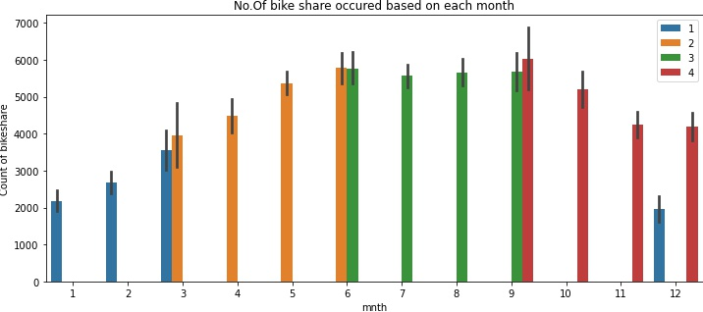
From the Data Dictionary we can understand that the mnth column is 1-12 months. From the graph based on month with season we can understand that the months with fall season has the highest number of bike share occurred out of all other seasons in a year. Which gives us the information that fall season at the month of June, July, August and September has the high demand or high usage of bike share occurred.

Slide 5
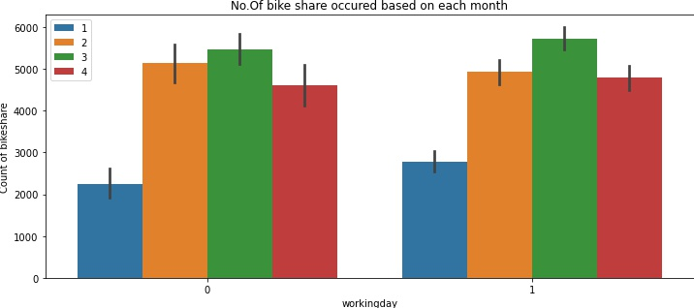
From the graph we can understand that in all seasons the bikes shared is high at the working day not on a holiday especially at the fall season. This weekday column in the given data gives the same information as given the weekday data.

Slide 6
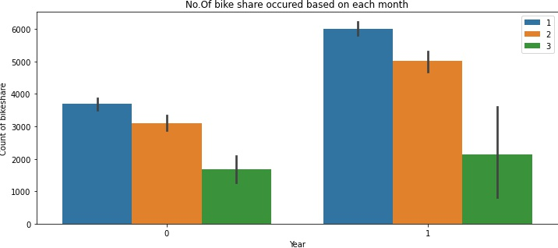
From the Data Dictionary we can know that weathersit mentioned in the data is the representation of the weather, they are 1:Clear, Few clouds, Partly cloudy, Partly cloudy, 2:Mist + Cloudy, Mist + Broken clouds, Mist + Few clouds, Mist, 3:Light Snow, Light Rain + Thunderstorm + Scattered clouds, Light Rain + Scattered clouds. From the graph we can understand that weathersit 1 has the highest number of bike share occurred in both the year 2018 and 2019, that is a good weather which makes the demand for bike share to rise.

Slide 7
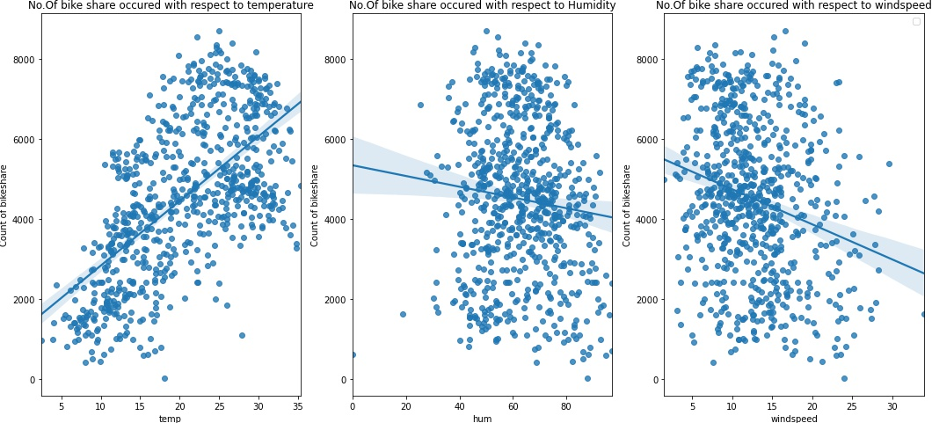
From the graph we can understand that the increase in temperature increses the demand for bike share between 20 to 30 degree. Where as increase in wind speed and humidity decrease the demand for bike share which is a non favorable period.

Slide 8
Result of Descriptive and Diagnostic Analysis
We can see through the data that season and weather place a vital role in the demand for bike sharing.
A good weather and a good temperature make the people to ride a bike to pass time or it can be the office workers and students using it because of thrill or less of cost.
Humid and bad weather can cause to decrease the demand of this bike share, due to risk factors people may avoid it.
Demand for bike share during Holidays is comparatively lesser that the working days.

Slide 9
According to Predictive Analysis
There is a good demand and assuming good welcoming among the users due to raise in demand of bike share compared to 2018 and 2019.
From Machine learning and performing Liner Regression we could predict that there will be a increase in demand for the bike sharing during the time of fall season and a less decrease in demand during bad weather and holiday.
Once the COVID situation is change and everything is settled, Business can proceed with the bike sharing, Since it has a good response from the people.
Increasing the bike availability during the time of fall season and good weather or during the month of June, July, August and September, Since these are having high demands.
Can reduce the availability during the month of December, January, February and march which is a winter season, and use these time to service the bikes.

Slide 10
Summary of Analysis
Analyzing the data provided by the company, they should focus on the following features:
Company should focus on developing business during Spring, Since it has the lowest demand of bike share.
Company should focus on expanding business during August and September, Since it has the highest demand for bike share.
Based on previous data it is expected to have a boom in number of users once situation comes back to normal, compared to 2019.
There would be less bookings during Light Snow or Rain, they could probably use this time to service the bikes without having business impact.
Hence when situation comes back to normal, the company should come up with new offers during spring when the weather is pleasant and also advertise a little for September as this is when business would be at its best.

